Slide 1
Why do we manage risks??

Slide 2
Classifying risks
Project
External unpredictable
Regulatory
Postulated events
External predictable
Market risks
Internal non-technical
Management
Technical
Legal, etc.
Natural hazards
Side effects
Completion
Operational
Environmental impacts
Social impacts
Currency exchanges
Inflation
Taxation
Schedule
Cost
Cash flow
Loss of potential
Changes in technology
Performance
Risks specific to technology
Design
Sheer size or complexity of project
Licences
Patent rights
Contractual
Outsider suit
Insider suit
Force major

Slide 3
Let us identify and categorise risks
Kuala Lumpur Flood Control Project
External unpredictable
External predictable
Internal non-technical
Technical
Legal
Record your answers
https://forms.gle/eTSQeRHrR9ECNd2e7

Slide 4


Slide 5
Evaluate Risks
The final step in evaluating risks is to evaluate each risk against a set of criteria and assign each risk a priority.
The most common tool used to do this is a risk matrix – a grid that allows you to plot the likelihood rating and consequence rating to determine an overall risk level

Slide 6
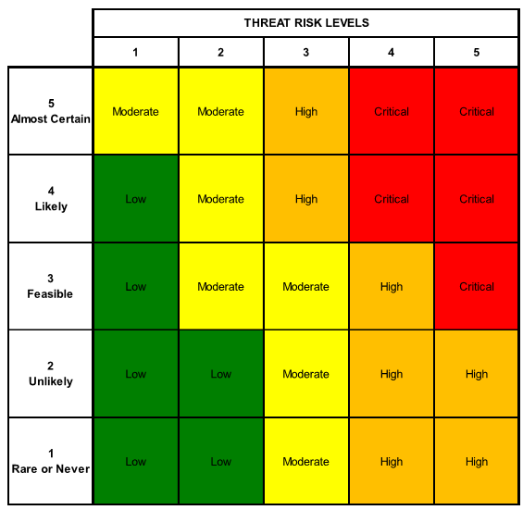

Slide 7
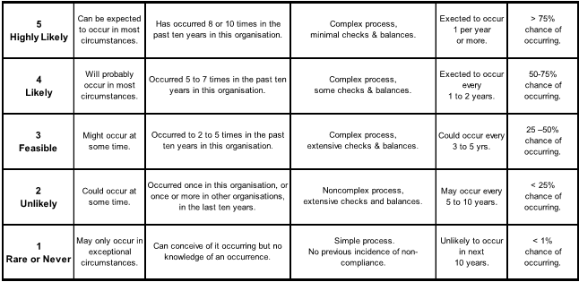
Dimension 1: Risk Likelihood

Slide 8
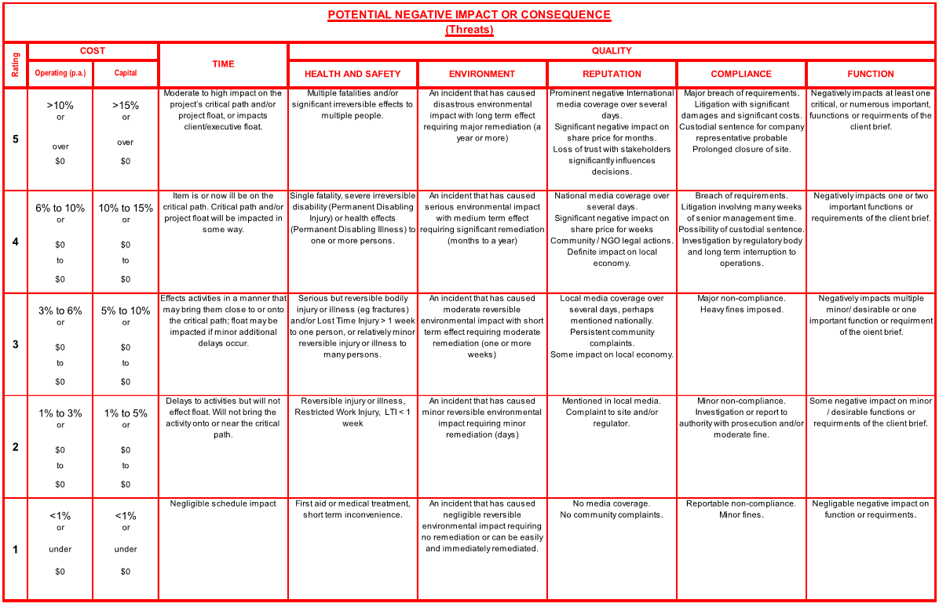
Dimension 2: Risk Consequences

Slide 9
Risk Management Plan
Determine the most appropriate and cost-effective risk response strategy for each identified risk
Allocate responsibility for the implementation and monitoring of each response strategy to a specific person
Document the risk response / mitigation strategies in the project risk register
Re-evaluate the risks, assuming that the risk management plan has been implemented to determine the residual risk level. If it is not acceptable, revise the risk management plan accordingly.

